Slide 1
NT 21

Slide 2
Week 1 : Introduction (Networks, Layered Model, Linux) Week 2 : IP Protocol, IP Addressing, IP Subnets , ARP, Netkit Week 3 : IP Routing, ICMP Week 4 : TCP/UDP Week 5 : Sockets Week 6 : NAT, DHCP, DNS Week 7 : Repetition
Program

Slide 3
Layered Communication: TCP/IP Protocols Overview
Application Layer
HTTP
DNS
FTP
DHCP
DHCP
Telnet
SMTP
Transport Layer
TCP
UDP
Network Layer
IP
DataLink Layer
Ethernet
Wifi
Bluetooth
Physical Layer
Ethernet
Wifi
Bluetooth

Slide 4

TCP/UDP
TCP and UDP are two most used transport layer protocols. TCP and UDP provide peer-to-peer communication for the application processes.

Slide 5
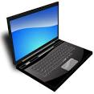

TCP/UDP Transport Layer
25
1340
6430
554
80
143
email
web
browser
…
streaming
client
streaming
server
web
server
…
email
192.168.1.1
173.12.122.1
Host-to-Host Communication (IP protocol)
Application Process-to-Application Process Communication (TCP/UDP protocol)

Slide 6
TCP/UDP TCP/UDP ports
Port addresses specify source and destination application process and are represented by a 16 bit unsigned number.
Well-known ports
Registered ports
Dynamic/private ports
0-1023
1024-49151
>49151
e.g. 21 for FTP, 80 for HTTP,
53 for DNS, …
Assigned by Internet Assigned
Number Authority
for vendors
Often dynamically (on demand)
Allocated for the source port
(ephemeral ports)

Slide 7
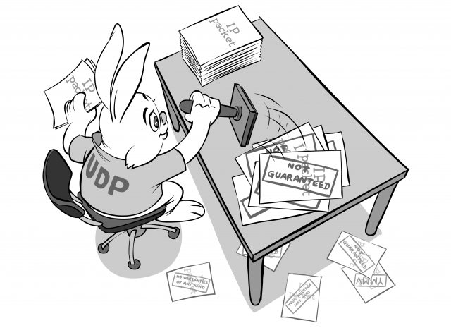
UDP User Datagram Protocol (UDP)
connection-less
error control with checksums optional
works with datagrams
unreliable
simple to implement
fast

Slide 8
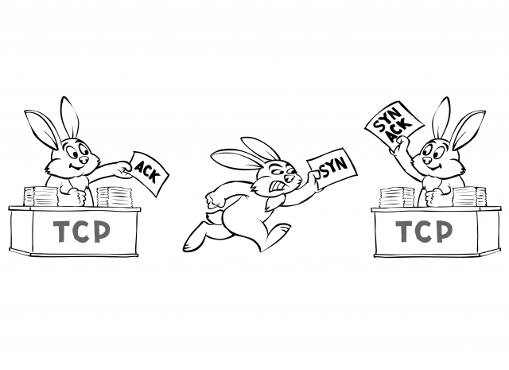
TCP Transmission Control Protocol (TCP)
connection-oriented
flow control
congestion control
error control
works with segments
stream-oriented
reliable
full-duplex

Slide 9
TCP TCP: Connection-oriented
SYN
1. Phase
Connection Establishment
(3 way handshake)
2. Phase
Data Transfer
3. Phase
Connection Tear-Down
(3 way handshake)
SERVER
CLIENT
SYN+ACK
ACK
DATA+ACK
DATA+ACK
DATA+ACK
DATA+ACK
FIN
FIN+ACK
ACK

Slide 10
TCP Flow Control
Hello !
How fast can I
send data ?
I’m busy now.
Send data
slowly
TCP Connection

Slide 11
TCP Flow Control
Sequence Numbers – keep track of how much data is sent. It is included in
every TCP packet. The sequence number represents the first byte number in the
TCP byte stream being sent to the receiver.
Acknowledgement Numbers – keep track of how much data was successfully
received. It is included in TCP packets when the sender’s data is being
acknowledged. The acknowledgment number represents the next byte in the TCP
byte stream the receiver is expecting.
Sliding Window Protocol – a protocol that keeps track of number of data being
sent, the number of data already acknowledged and how much data the receiver
can buffer before sending the data to the application (receive window).

Slide 12
TCP/UDP TCP Sliding Window Example
Receiver’s buffer
size 4096
Application
sends 2048
bytes of data
SENDER
2048
RECEIVER
Empty
Seq=0
2048
Ack=2048 WinSize=2048
Application
sends next 2048
bytes of data
2048
Seq=2048
Full
Application
is blocked
Application
processes 2048 bytes
Ack=4096 WinSize=0
2048
Ack=4096 WinSize=2048
1024
Seq=4096
1024
2048

Slide 13
TCP Error Control
Checksum – used to detect corrupted data
Retransmissions – lost and corrupted data are retransmitted
Sequence/acknowledgment numbers, acknowledgments and sliding window
protocol are also used for error control

Slide 14
TCP Error Control Examples (1)
Data gets corrupted
during transfer
DATA
Timeout
Data is dropped
by the receiver
DATA
Data is
retransmitted
ACK

Slide 15
TCP Error Control Examples (2)
Packet lost during transfer
DATA
Timeout
DATA
Data is
retransmitted
ACK

Slide 16
TCP Error Control Examples (3)
Acknowledgement lost
DATA
Timeout
ACK
Data is
retransmitted,
duplicate packets
DATA
ACK

Slide 17
TCP Error Control Examples (4)
Early Timeout
DATA
Timeout
ACK
DATA
Data is
retransmitted,
duplicate packets
ACK

